Slide 1
Day 2: Intro-extended and WEKA
Gaurav Moghe
Assistant Professor, Plant Biology
PLBIO 4000/6000

Slide 2
Overview of the previous lecture
Supervised
Decision Trees
Random Forest
Bagging and Boosting
Support Vector Machines
Logistic Regression
Unsupervised
K-means Clustering
Principal Components Analysis

Slide 3
Overview
Feature Engineering
Introduction to platforms for ML
WEKA
Introduction to today’s dataset

Slide 4
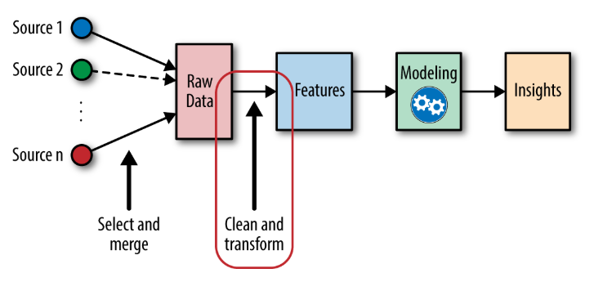
Feature Engineering
https://www.omnisci.com/technical-glossary/feature-engineering

Slide 5
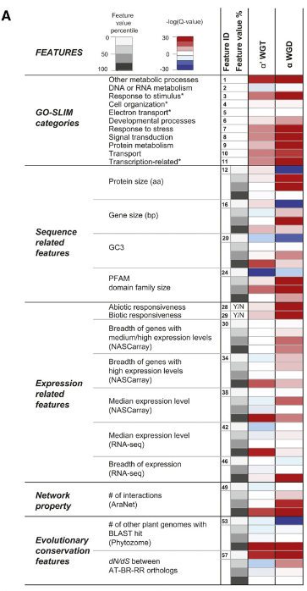
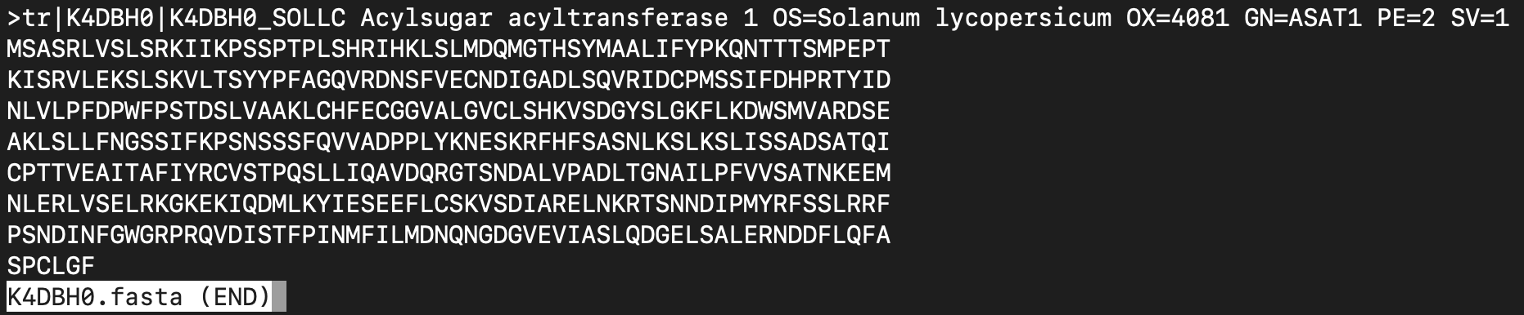
Feature Engineering
Which features are important?
Where do I get them?
What kind of feature transformation is required?
What kind of formatting is required?

Slide 6
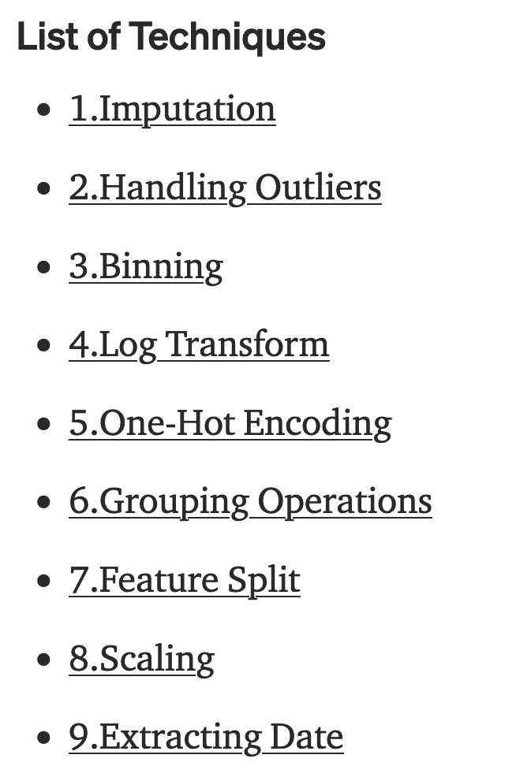
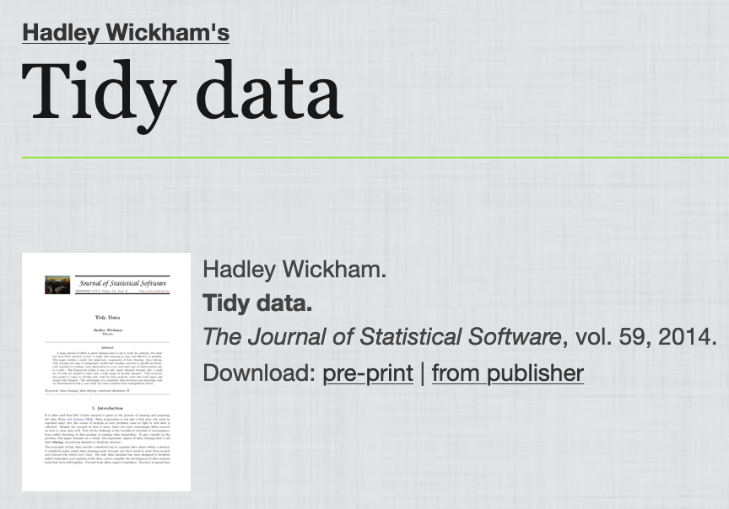
Feature transformation
http://vita.had.co.nz/papers/tidy-data.html
https://towardsdatascience.com/feature-engineering-for-machine-learning-3a5e293a5114

Slide 7
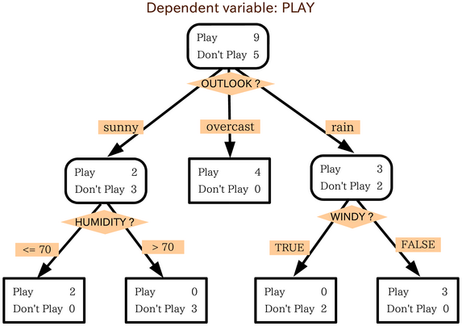
Categorical features: Sometimes a problem
CLASS | HUMID-ITY | WINDY? | OUTLOOK
PLAY | 90 | NO | RAIN
PLAY | 85 | NO | OVERCAST
PLAY | 80 | NO | RAIN
PLAY | 70 | YES | OVERCAST
PLAY | 65 | YES | OVERCAST
PLAY | 60 | NO | SUNNY
PLAY | 50 | NO | RAIN
PLAY | 45 | YES | SUNNY
PLAY | 40 | NO | OVERCAST
DON'T | 95 | YES | SUNNY
DON'T | 90 | YES | SUNNY
DON'T | 80 | NO | SUNNY
DON'T | 45 | YES | RAIN
DON'T | 30 | YES | RAIN
Cannot use categorical data
SVMs
Regression-based
Can use categorical data
Tree-based classifiers

Slide 8
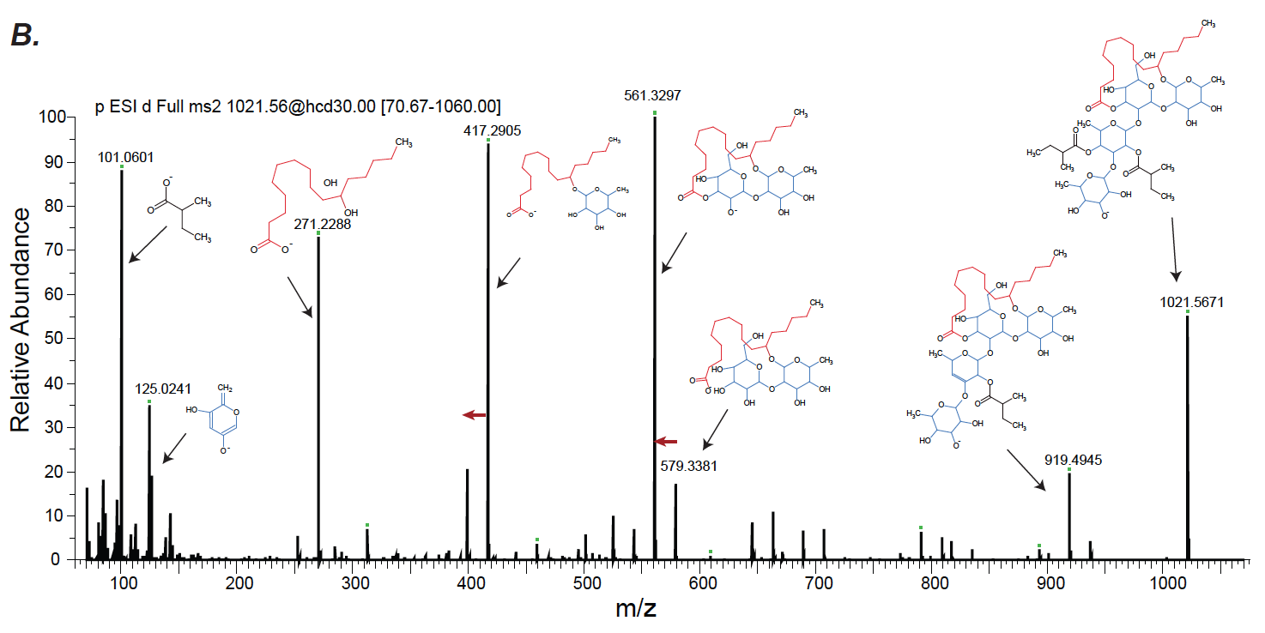
Example application: One-hot encoding

Slide 9
Example application: One-hot encoding
 | m/z
Instance | 50 | 51 | 52 | 53… | …2000
Compound1 | 1 | 0 | 0 | 1 | 1
Compound2 | 0 | 0 | 1 | 0 | 0
Compound3 | 0 | 0 | 0 | 0 | 1
Feature Selection

Slide 10
Popular platforms for ML
Purpose | Packages
Free, non-GUI | R (caret), Python
Free, +GUI | Weka
Non-free, +GUI | MATLAB, Wolfram
Industry applications | RapidMiner, MATLAB, Google Cloud, Azure ML, IBM Watson, KNIME

Slide 11
Popular Python-based packages for ML
Purpose | Packages
Data manipulation | Pandas
Data visualization | Matplotlib, Seaborn, Yellowbrick
Feature engineering | Feature-engine, Feature-tools
Numerical functionalities | NumPy, SciPy
Non deep-learning ML | Scikit-learn, PyCaret
Deep learning ML | PyTorch (Facebook), TensorFlow (Google), Keras (high-level framework), Caffe (Berkeley), Theano (mathematical operations), Deeplearning4j (JAVA)

Slide 12
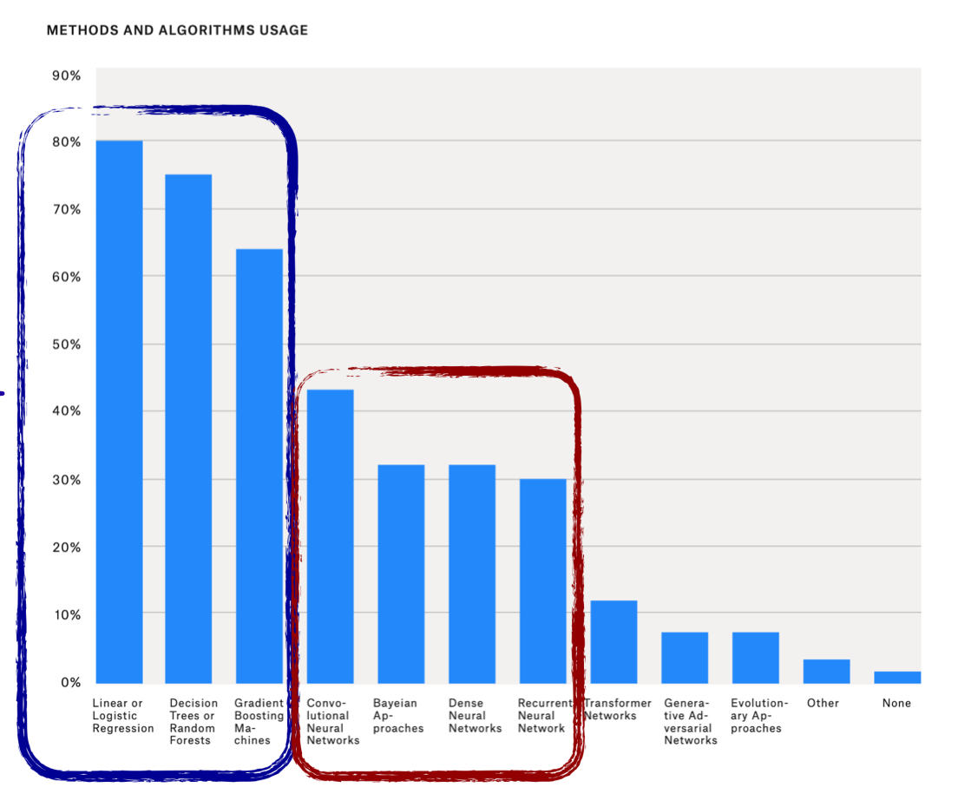
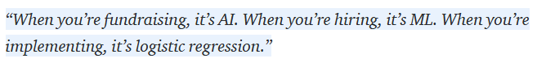
Popular algorithms
https://www.kdnuggets.com/2020/04/machine-learning-ai-industry.html

Slide 13

Waikato Environment for Knowledge Analysis (WEKA)
Java based software
GUI – very simple learning curve
You can also run it on the command line using Java
One of the first platforms, but better platforms available now
Not used as much for broad deployment

Slide 14
About the dataset

Slide 15
Compound identification using LC-MS is still a big challenge
<5% of the peaks in tomato with MS/MS information could be annotated using database search
>1 million estimated plant metabolites
50-100K documented
Compounds with LC-MS/MS information in MassBank of North America (<20,000)

Slide 16
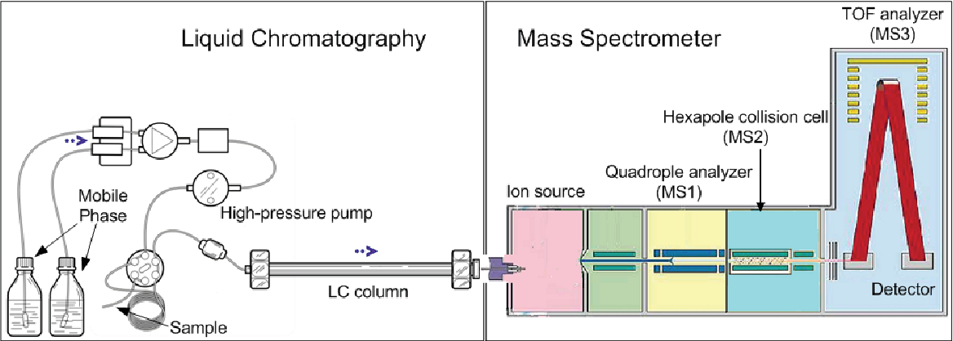
LC-MS/MS overview
Liu et al, 2011

Slide 17
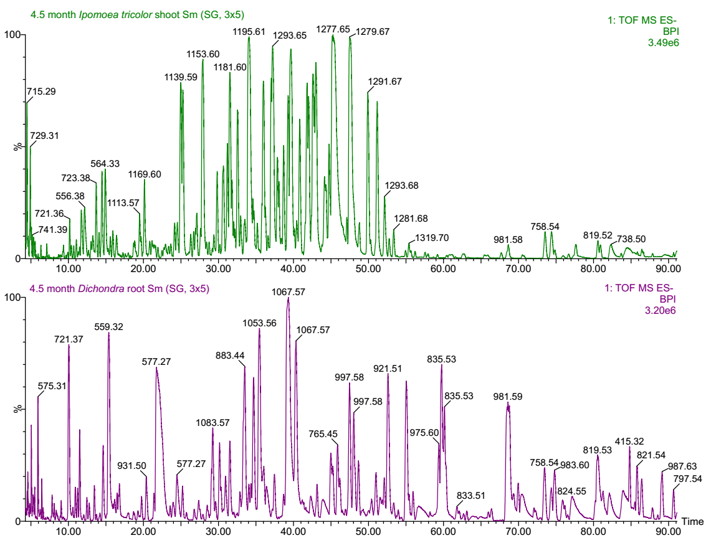
Properties that can be used for classification
Retention time
MS/MS fragmentation patterns
Isotope patterns
Monoisotopic mass
Formula
Molecular cross-section*

Slide 18
Properties that can be used for classification
Retention time
MS/MS fragmentation patterns
Isotope patterns
Monoisotopic mass
Formula
Molecular cross-section*

Slide 19
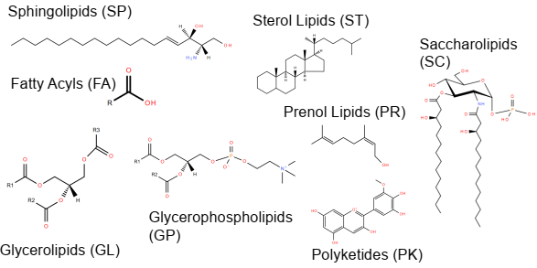
Lipid MAPS database has ~42,000 lipids organized into a hierarchical ontology
Ontology

Slide 20
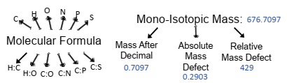
Features

Slide 21

GUI Chooser

Slide 22
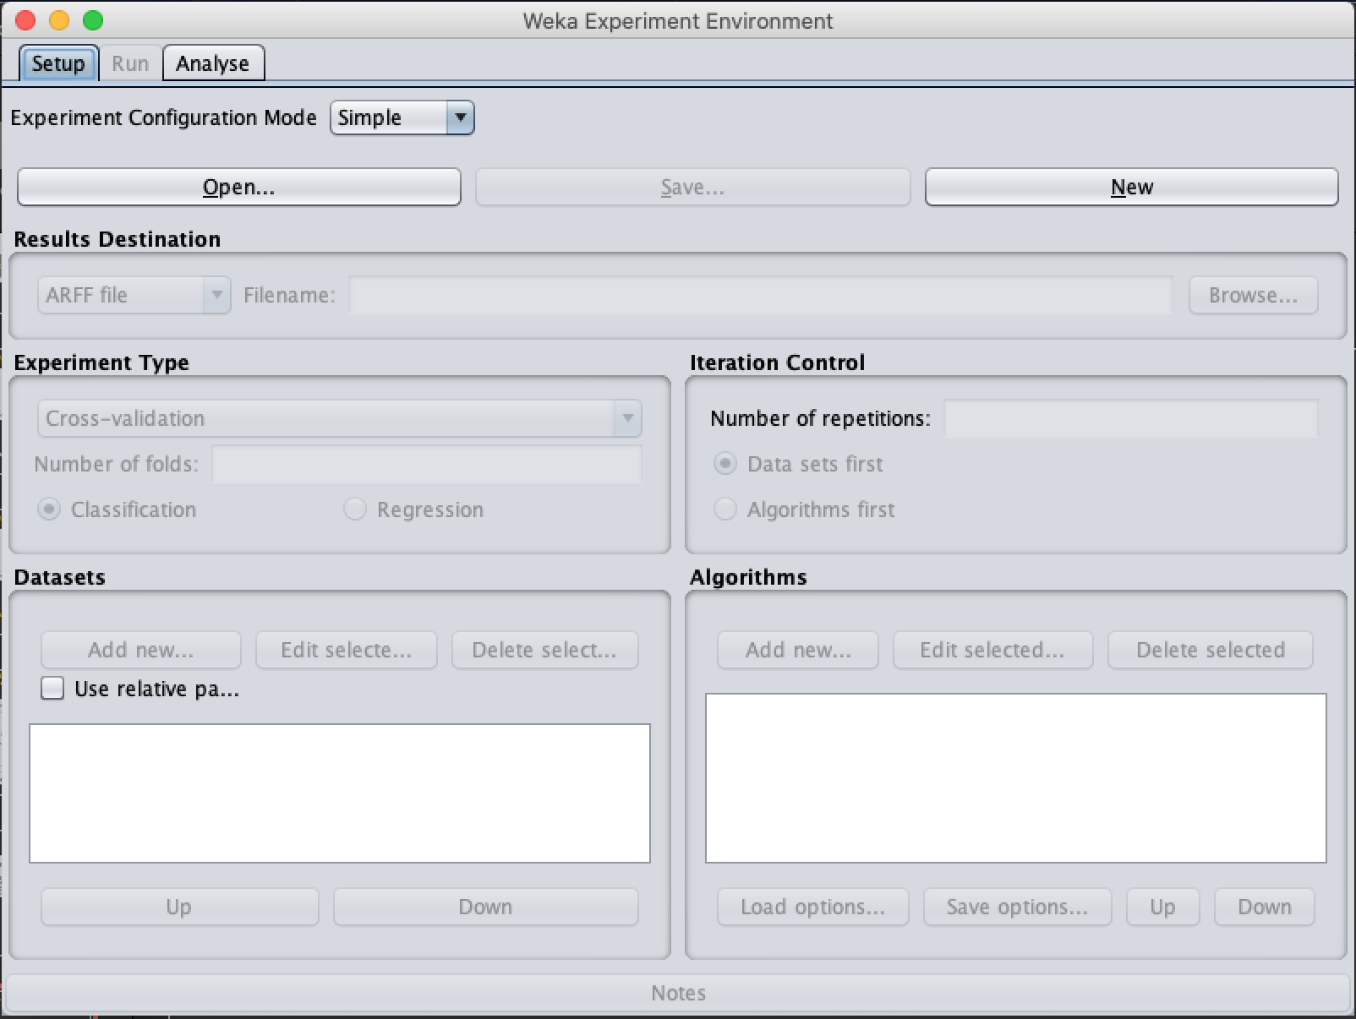
WEKA Experimenter

Slide 23
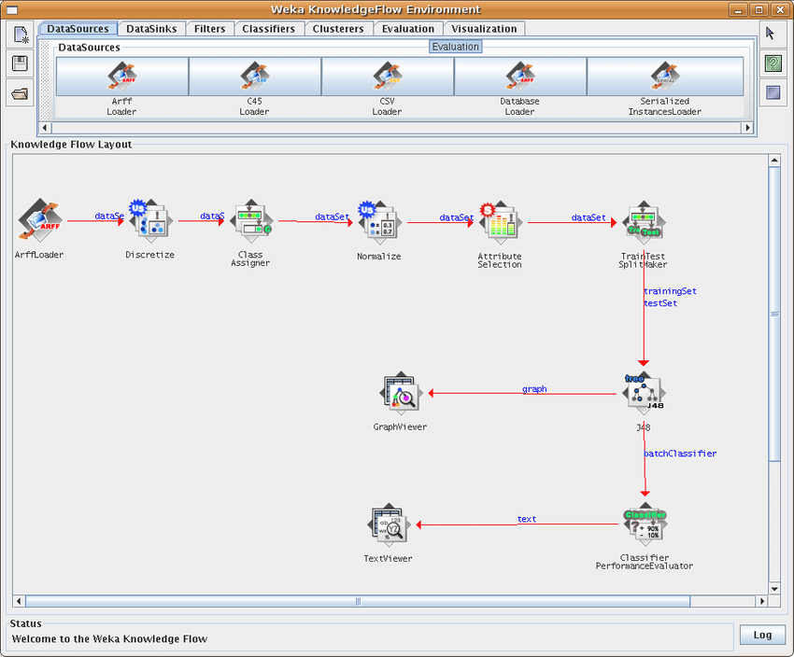
WEKA Knowledge Flow

Slide 24
Weka on the command line
java -classpath “./weka.jar" weka.classifiers.meta.FilteredClassifier -t <path-to-training-file> -c last -p 1 -distribution -F "weka.filters.MultiFilter -F \"weka.filters.supervised.instance.SpreadSubsample -M 4\" -F \"weka.filters.unsupervised.attribute.RemoveType -T string\"" -W weka.classifiers.trees.RandomForest -- -I 100 -K 5 -S 1 > <path-to-output>
J48 Decision Tree: 30 models
Random Forests: 42 models
Logistic Regression: 36 models
SMO/SVM: 36 models
Naïve Bayes: 6 models
NBTree: 6 models

Slide 25

What we will do today
Use the input file for Weka
Run different Weka variations and compare the results
Try and explain why the performance is the way it is
Elizabeth Mahood
Grad student, Moghe Lab

Slide 26

Weka Workflow
Open WEKA. This menu should pop up. Press the Explorer button

Slide 27
Weka Input file
Weka takes an input file in a special format -- .arff
Open up the .arff file (found on Canvas) with Excel or a plain text editor (such as Wordpad).
Important features of the .arff file:
Right below the @data line, each instance is listed with its feature values separated by commas.
The header (top of the file) lists the name of the features and what type they are (numeric, string, etc.). The features are listed in the order they appear in each instance.

Slide 28
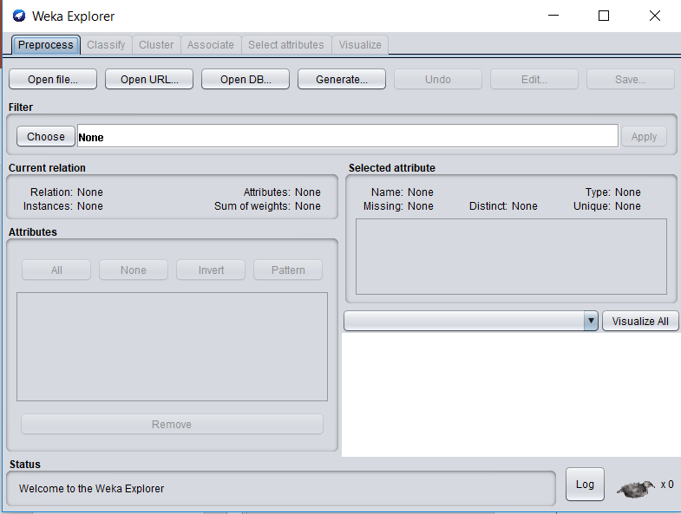
First we must load the .arff file
(Navigate to where your .arff file is an load it in)

Slide 29
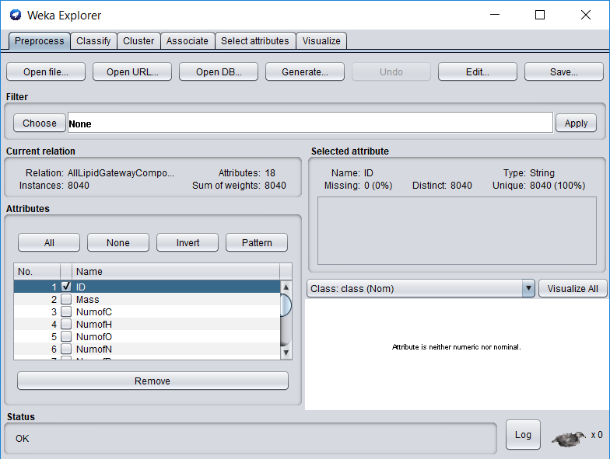
Remove ID (we’ll add it back in later)
Check the box and hit Remove

Slide 30
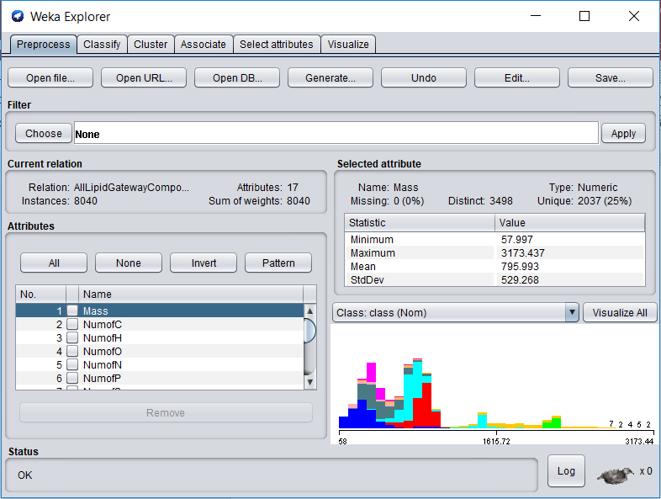
Look at Feature Distributions
Click this

Slide 31
Analyze!
It’s very important to have features that distinguish among your classes. Which features differentiate one class (or multiple classes) from the others?

Slide 32
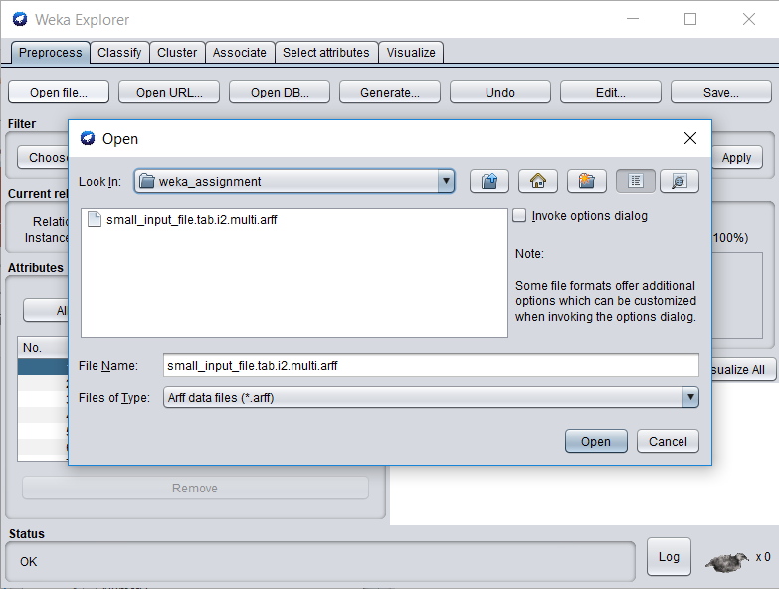
Reload .arff to add back ID
1) Click this
2) This box should appear
3) Click this

Slide 33
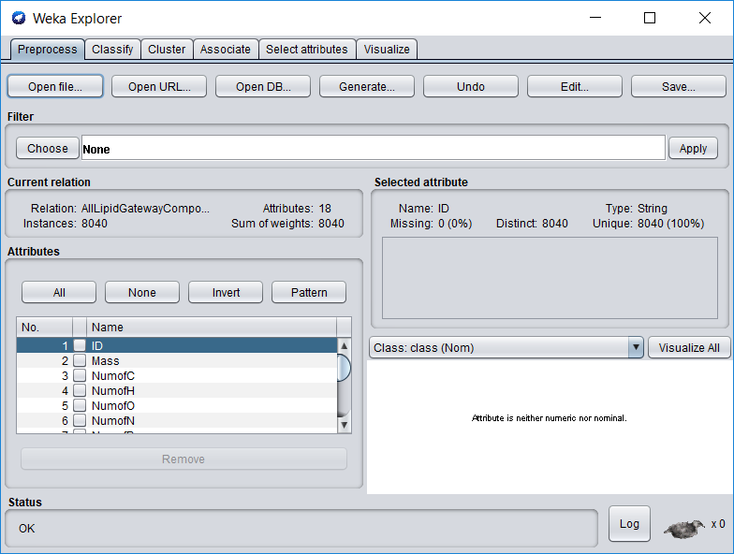
Add some filters
Once the window is open, click on the arrows to see various available options

Slide 34
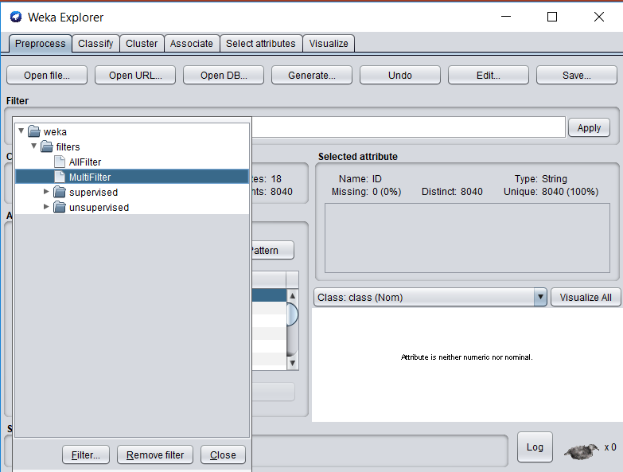
Select Multifilter
To find Multifilter: Open the filters folder. This allows us to select multiple subsequent filters.

Slide 35
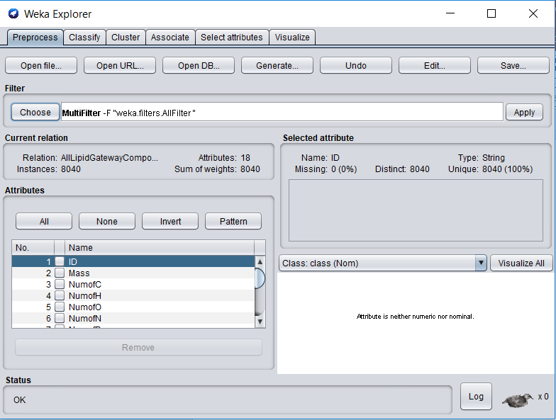
You must Click Apply to Add Filters
Click Apply

Slide 36
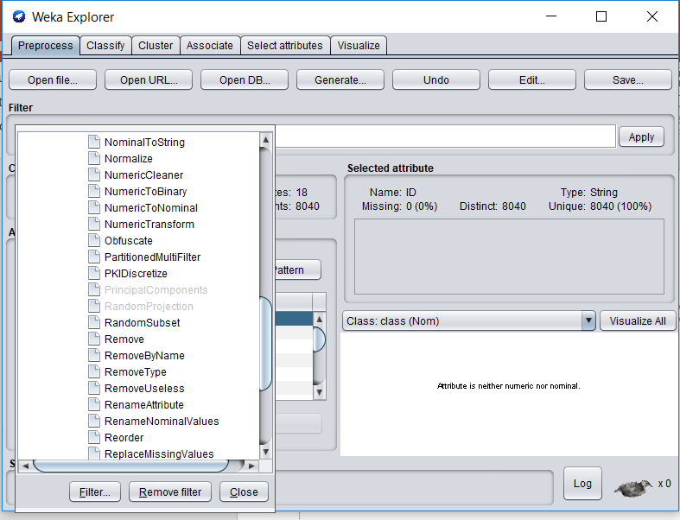
Select RemoveType
To find RemoveType: Open filters, then Unsupervised, then Attribute. Scroll down.
This filter will make sure Weka doesn’t think the instance ID is a feature for classification.
Remember to Click Apply after you’ve selected it!!!!!!!

Slide 37
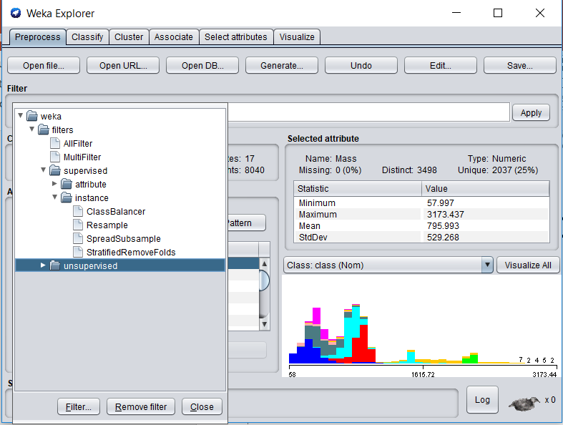
Select SpreadSubsample
To find SpreadSubsample: Click on filters, then Supervised, then instance. This will make sure that there is a maximum ratio between the largest and the smallest class represented in any given cv fold.
DON’T click Apply yet!!!!!!

Slide 38
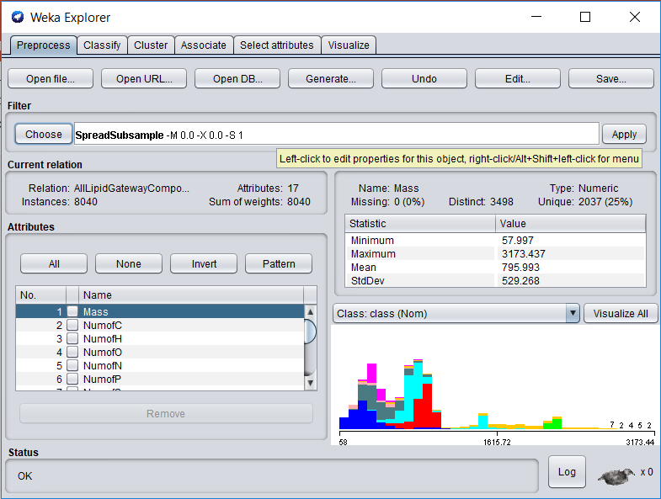
Right Click to edit the parameters of your filters
Right click here

Slide 39
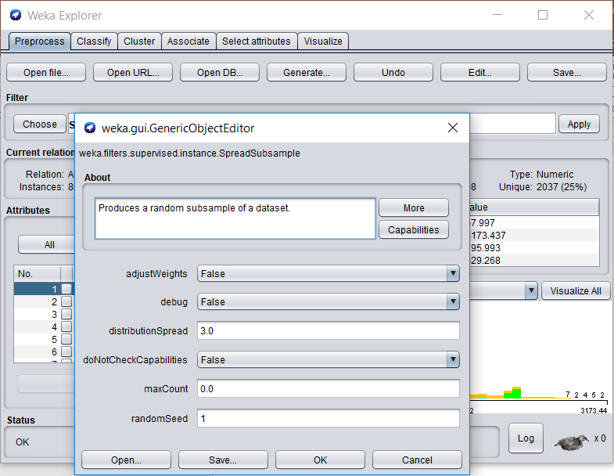
This box should pop up
3) Click Apply
1) Change this to 3. The largest class will be a max of 3x larger than the smallest class
2) Click OK

Slide 40
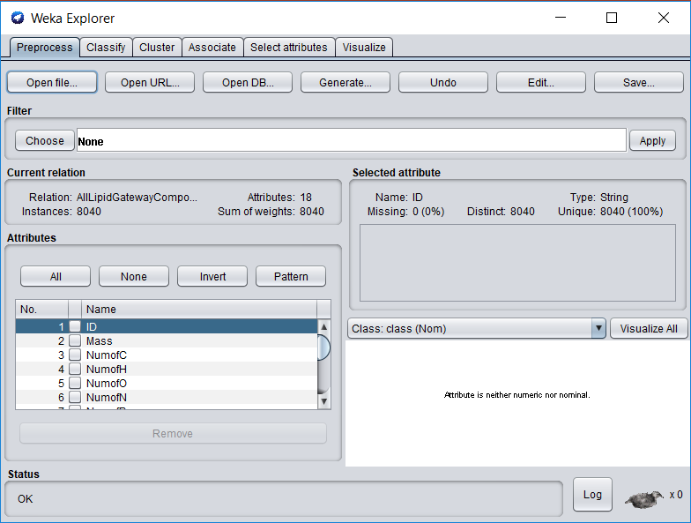
Head to the Classify Tab

Slide 41
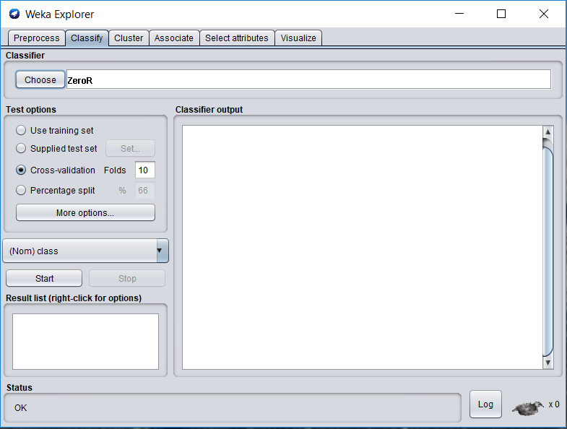
Now we’re going to choose a classifier!
Click this button to choose your classifier

Slide 42
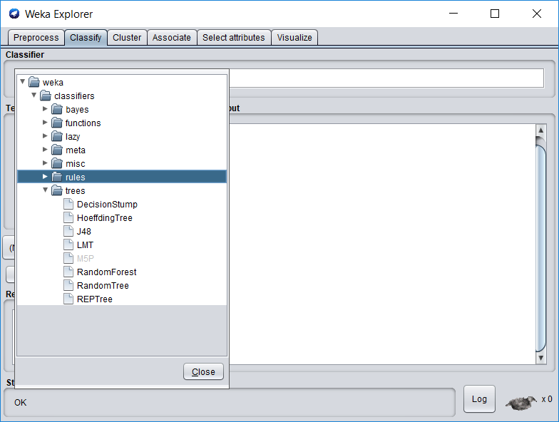
We’ll use Random Forest
To find Random Forest, open trees.

Slide 43
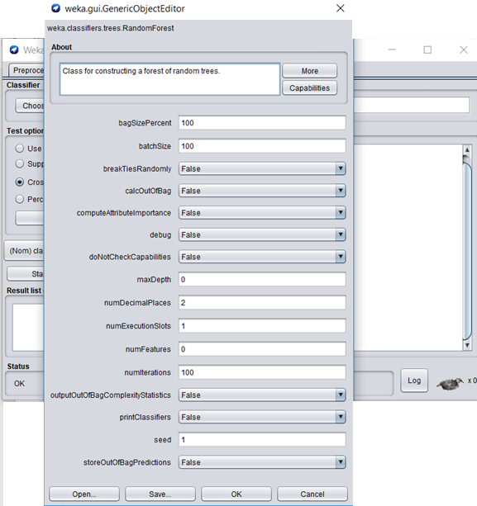
Right click on the panel to bring up this menu
Right click on this

Slide 44
Change parameters of Random Forest
Change this to ‘True’. We want to see how important each feature is for classifying.
Change this to 5.
Random Forest will randomly choose 5 features to look at for each split.
After changing those 2, click OK

Slide 45
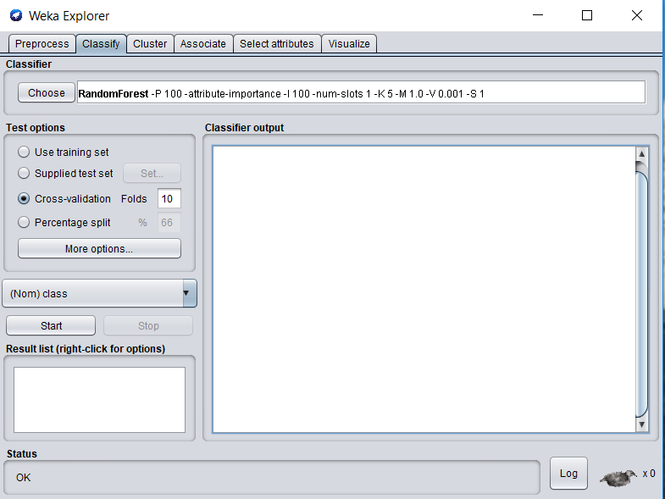
Next click ‘More Options’

Slide 46
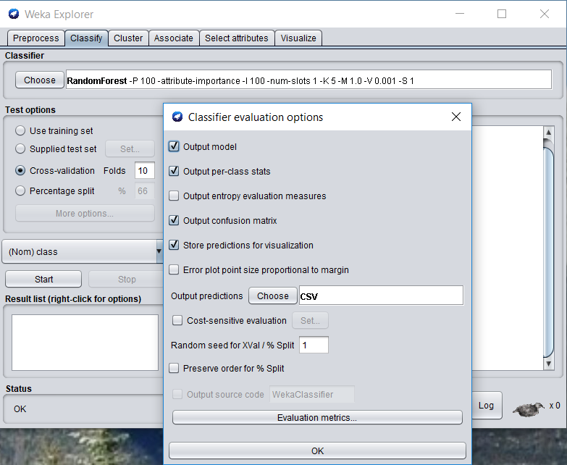
We want to output the prediction of each instance as a .csv file
Click ‘Choose’ and select CSV
Then click OK

Slide 47
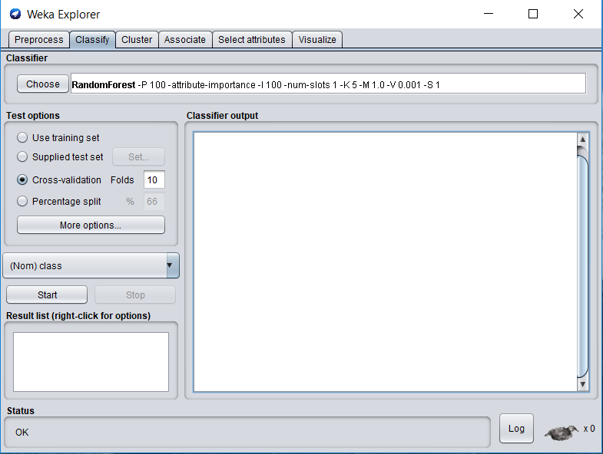
Now We’re ready to classify!
Your screen should look like this, by the way.
Click Start

Slide 48
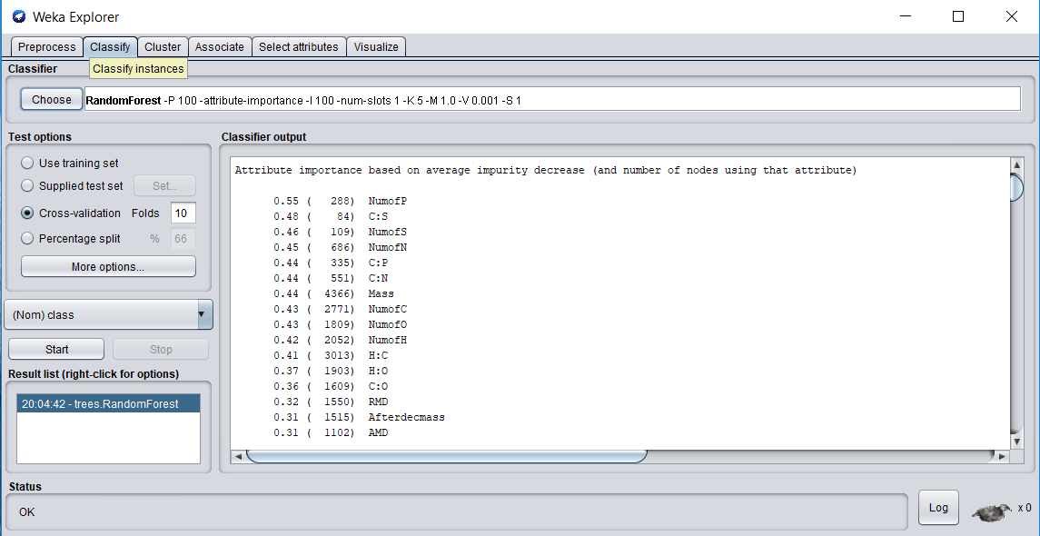
Let’s look at the output!
Here’s attribute importance, calculated via Gini index

Slide 49
Gini index
All ML classifiers operate by minimizing some classification error. For example, linear regression makes a “line of best fit” by minimizing the Sum of Squared Error between the line and all the points it is fitting.
Classification tree algorithms (like Random Forests) try to minimize the Gini Index (or the Cross Entropy / Information Gain).

Slide 50
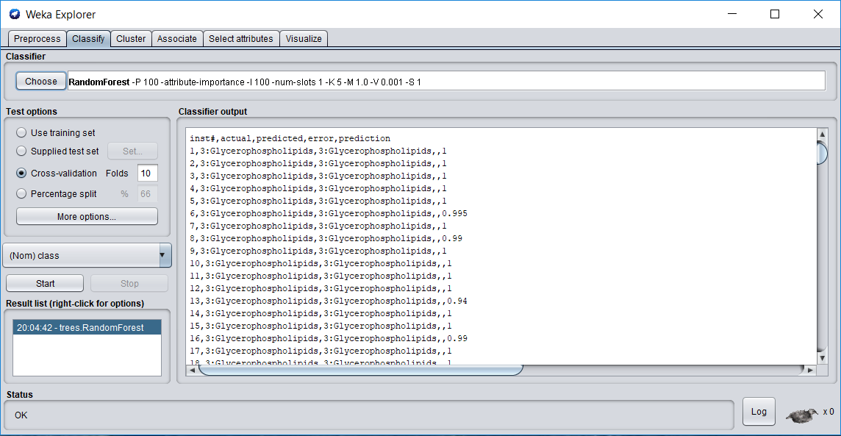
Here’s the prediction and prediction probability of each instance

Slide 51
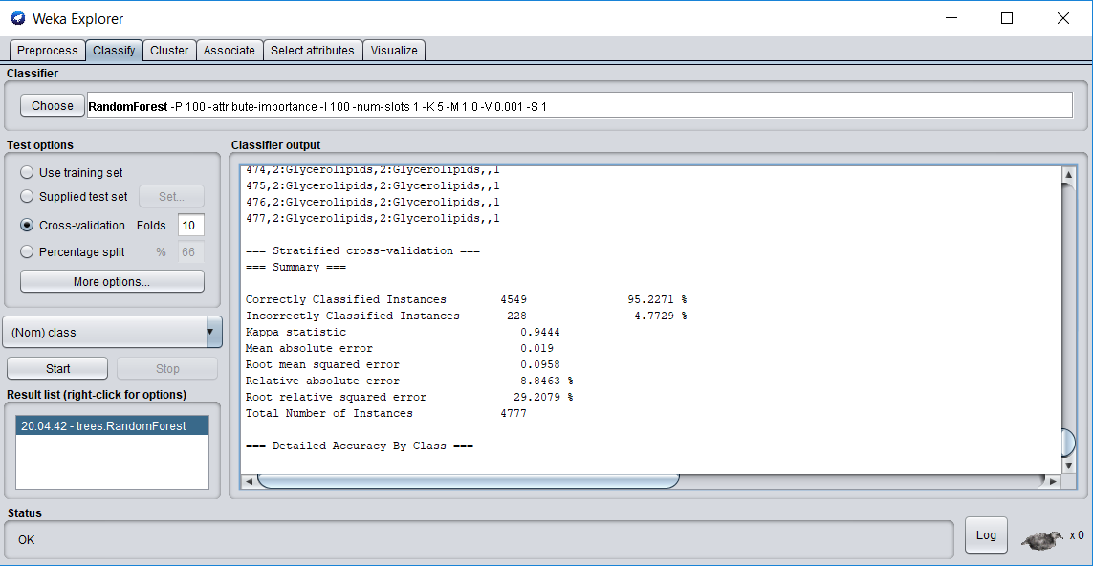
Here are some stats on overall performance

Slide 52
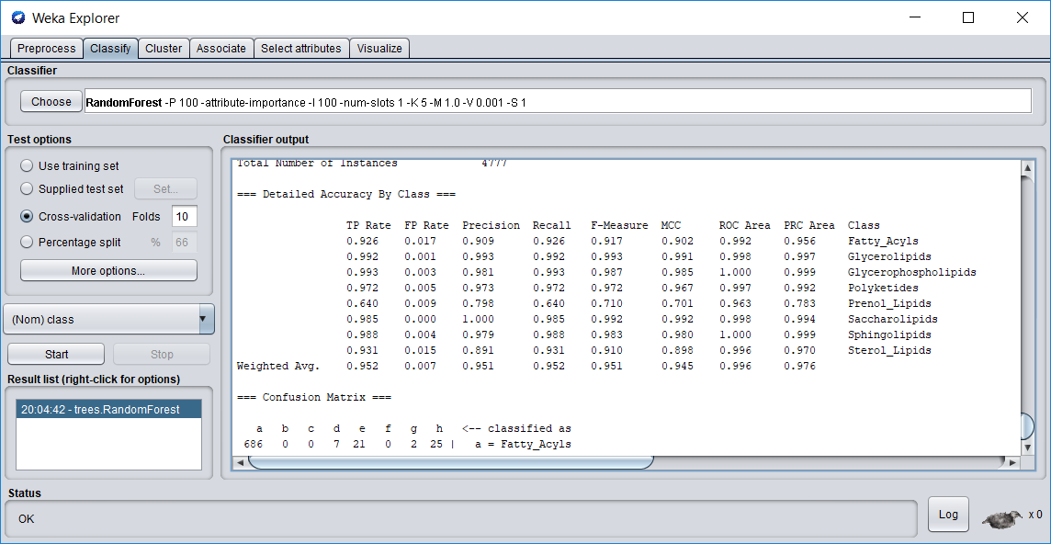
Important stats for each class

Slide 53
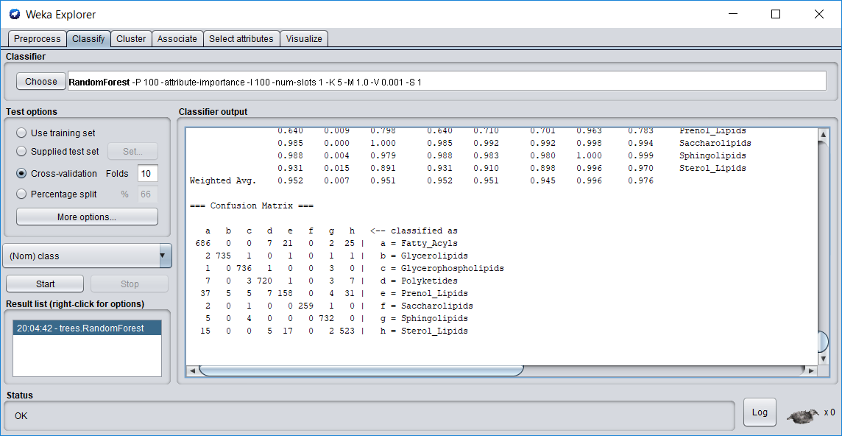
And finally the confusion matrix

Slide 54
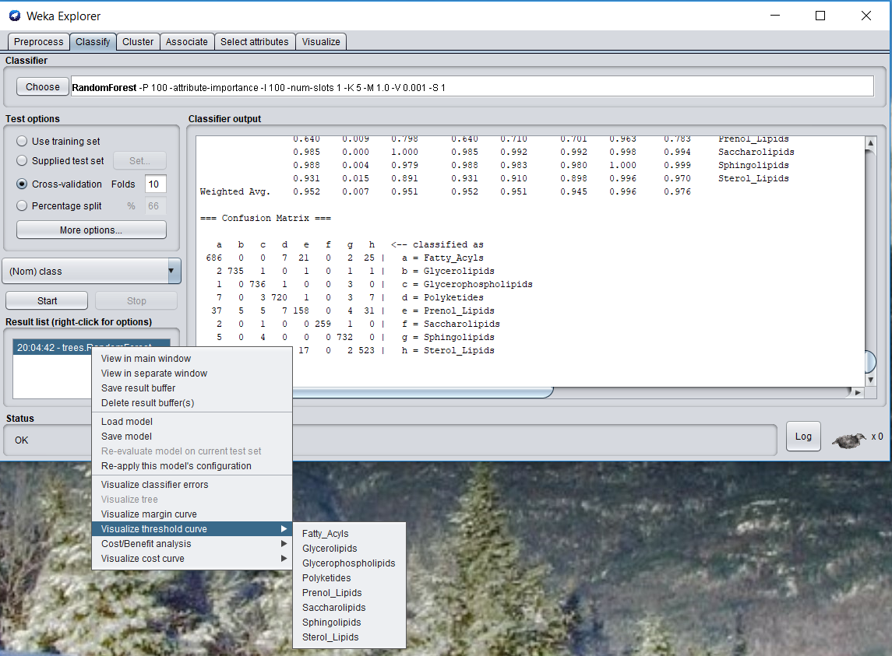
Some more things to look at: AUROC plots
Right click on the highlighted text in this box
Here you can view AUROC plots and other curves
Select a class to view its curves

Slide 55
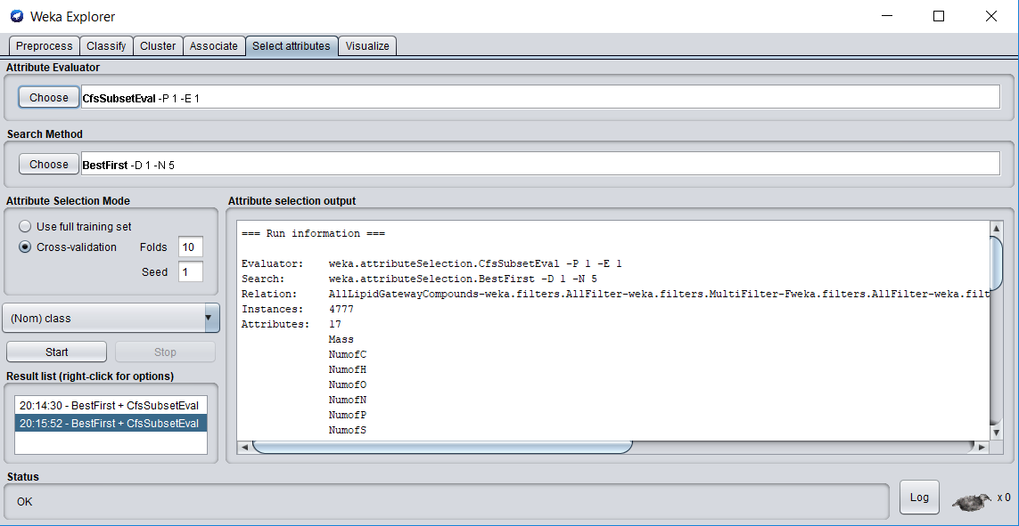
Some more things to look at: Attribute Importance
1) Head to this tab
2) Select your choices for both of these
3) Start!
Your results here may differ from the results we saw earlier….

Slide 56
Run the following variations and compare AUROCs
A regression model
A decision tree model
An SVM
A Naïve Bayes classifier
With Random Forest, change cross-validation fold to 5, and see if you notice any difference

Slide 57
Results – F1 score – Prenol lipids
Algorithm | Student 1 | Student 2
RF- 10 fold | 0.71 | 0.701
SVM (SMO) | 0.008 | 0.008
NB | 0.23, 0.14 | 0.18
LogisticSimple | 0.253 | 0.288
Decision Tree | 0.677 | 0.648
RF – 5 fold | 0.711 | 0.711

